Slide 1

GO
SIGN TO TEXT TRANSCRIPT
DEEPAK V
S3 MCA

Slide 2
ABSTRACT
Sign language is the means of communication for hearing-impaired people.
There is a challenge for ordinary people to communicate with deaf people, which makes this system helpful in assisting them.
This project aims at implementing computer vision, which can take the signs from the users and convert them into text in real time.

Slide 3
MODULE DESCRIPTION

Slide 4
MODULES
Image Capturing
Preprocessing
Classification
Prediction
Sign gestures are captured and processed using the OpenCV python library.
The captured gesture is resized, converted to a grayscale image, and the noise is filtered to achieve prediction with high accuracy.
The classification and predication are done using a convolution neural network (CNN).
The converted real-time text appears in the text box. Generated text can be edited if necessary, and there is an option to save it on a clipboard, which can be pasted on any application we want.

Slide 5
EXISTING VS PROPOSED SYSTEM

Slide 6
Sl No | Existing System | Proposed System
1 | Only Prototype models are available. | This system is not like a prototype model.
2 | Since Its a prototype model lack of good GUI. | This system having good and simplistic GUI using tkinter package in python.
3 | This system only avails to show the letter for corresponding sign language. | This system takes advantage for making these letters and form a sentence on text field.
4 | The letters generated can’t used further. | The copy to clipboard feature helps to use this generated text on any application.

Slide 7
TECHNOLOGIES
USED

Slide 8




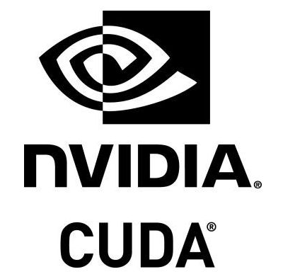



IDE’s | PLATFORMS | TOOLS

Slide 9
PROCESS FLOW PIPELINE

Slide 10
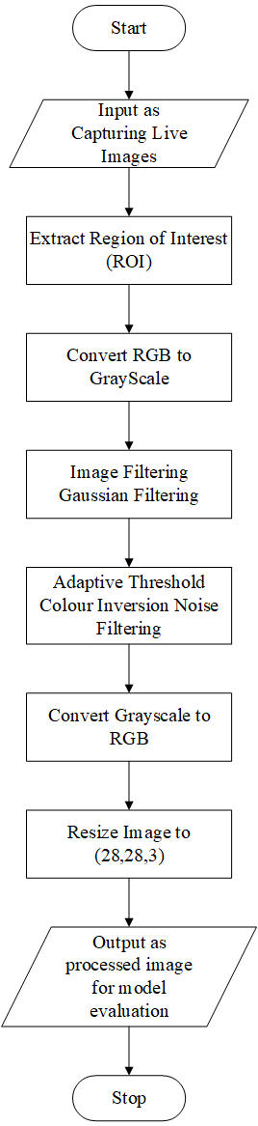
Image Pre-processing Pipeline

Slide 11
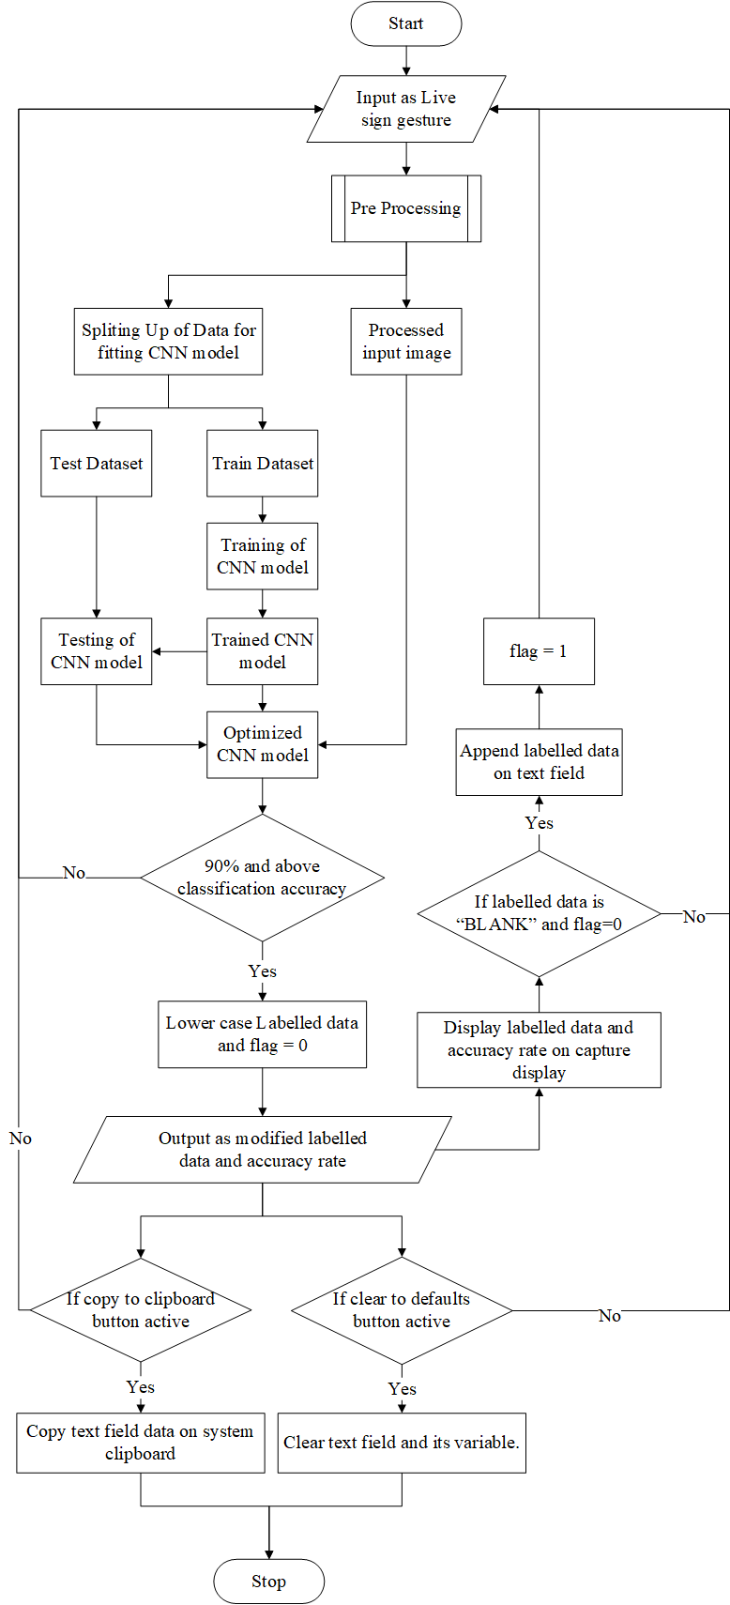
Proposed System Pipeline

Slide 12
MODEL ARCHITECTURE

Slide 13
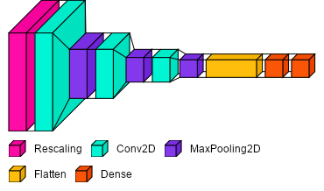
Model: "sequential"
_________________________________________________________________
Layer (type) Output Shape Param #
=================================================================
rescaling_1 (Rescaling) (None, 28, 28, 3) 0
conv2d (Conv2D) (None, 28, 28, 16) 448
max_pooling2d (MaxPooling2D (None, 14, 14, 16) 0
)
conv2d_1 (Conv2D) (None, 14, 14, 32) 4640
max_pooling2d_1 (MaxPooling (None, 7, 7, 32) 0
2D)
conv2d_2 (Conv2D) (None, 7, 7, 64) 18496
max_pooling2d_2 (MaxPooling (None, 3, 3, 64) 0
2D)
flatten (Flatten) (None, 576) 0
dense (Dense) (None, 128) 73856
dense_1 (Dense) (None, 37) 4773
=================================================================
Total params: 102,213
Trainable params: 102,213
Non-trainable params: 0
_________________________________________________________________
ReLU (rectified linear unit) is the activation function used
In conv2d, dense

Slide 14
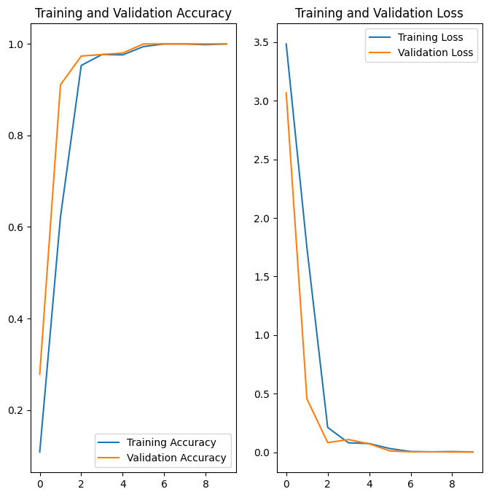
Accuracy and Loss Graph

Slide 15
SCREENSHOTS

Slide 16
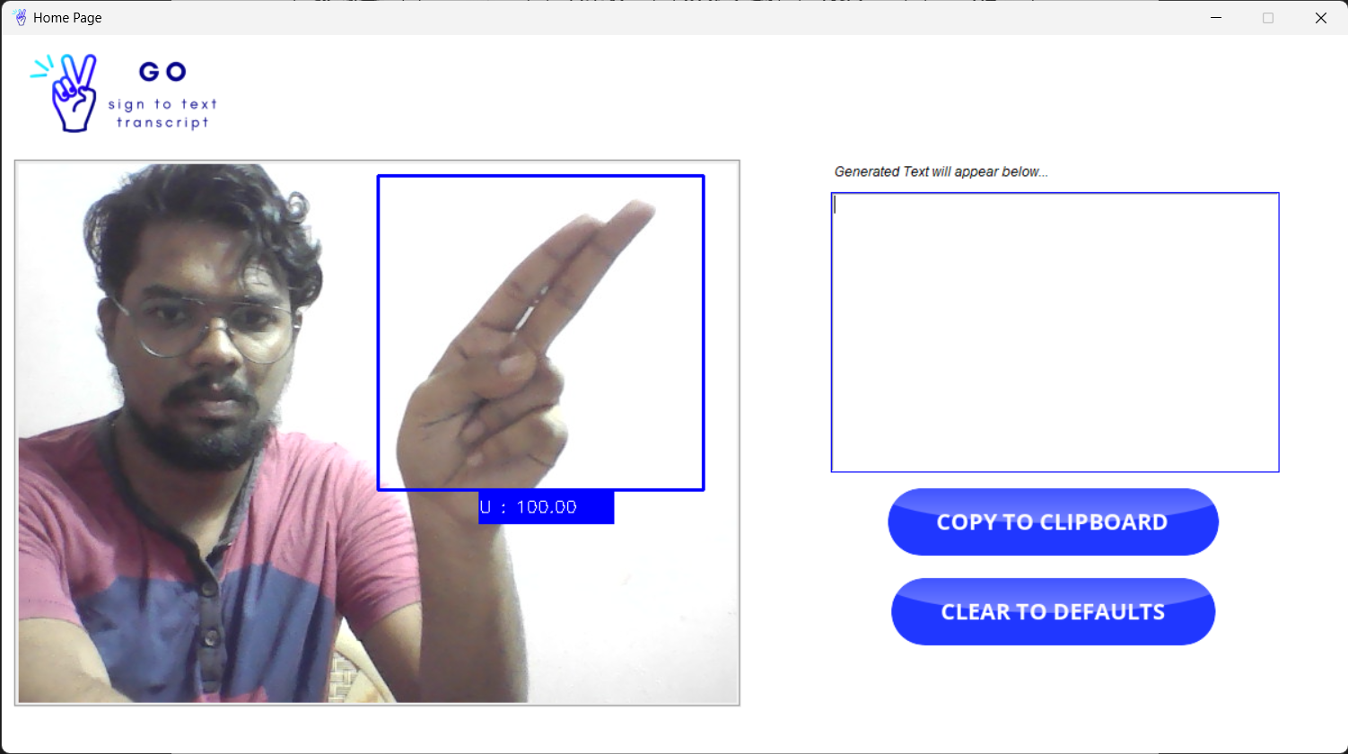
Model predicted sign

Slide 17
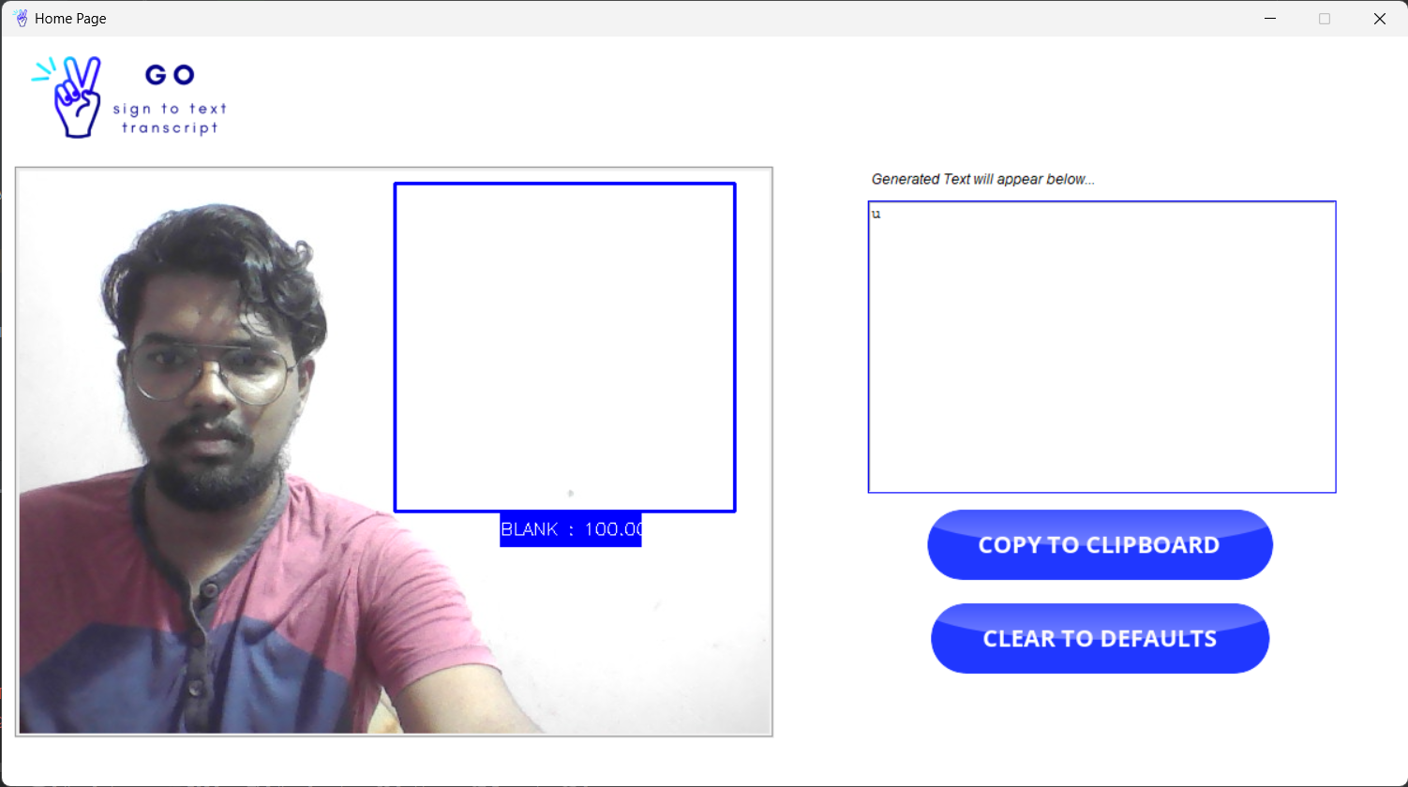
Corresponding letter appeared

Slide 18
We can copy the text to any application

Slide 19
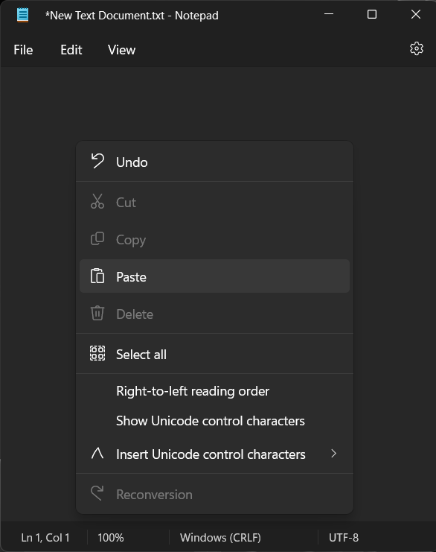
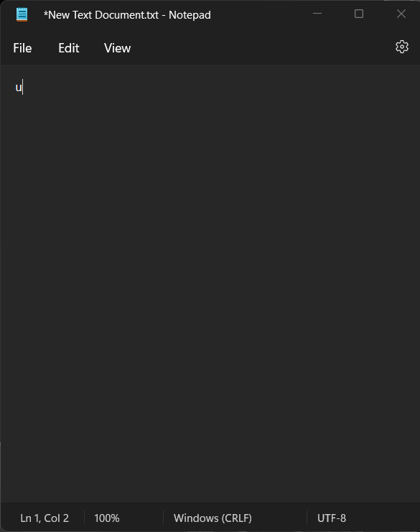

Slide 20
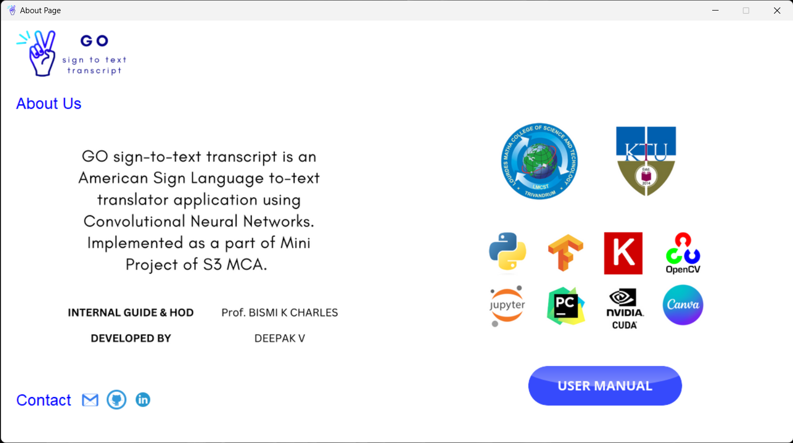

Slide 21
CONCLUSIONS
The project has been completed as per the system requirements.
The implementation and testing has been done in a progressive manner.
During this duration of this project implementation. I learned the following things :
Python
Open CV
Data Science and Machine Learning
Deep learning
TensorFlow
Keras

Slide 22
FUTURE ENHANCEMENTS
Implementation of mediapipe rather than simple opencv image capturing.
Conversion sign language to audio as an option.
Introduce new custom signs and can be trained by end users in abstract manner.
Sharing of custom sign model to other users and can be used through this application.
Creating a online community to excavate and elevate the enhancement of this application.

Slide 23
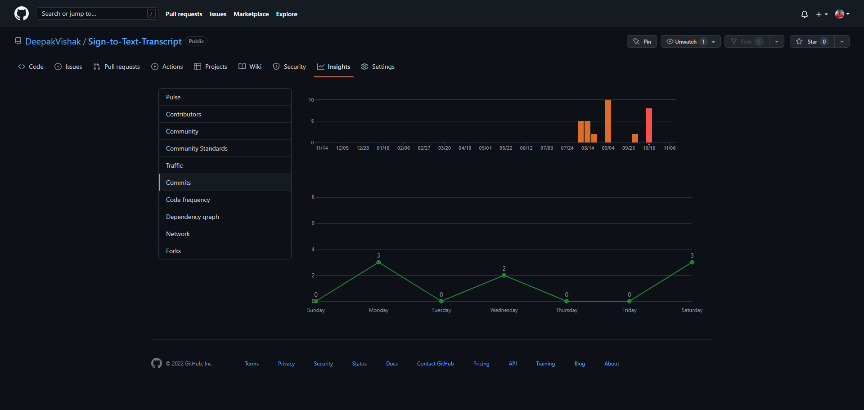
GIT HISTORY

Slide 24
REFERENCES
Sign Language Translation
Published in: 2020 6th International Conference on Advanced Computing and
Communication Systems (ICACCS)
Conducted by: IEEE
Date of Conference: 06-07 March 2020
Conference Location: Coimbatore, India

Slide 25
THANK YOU

